Slide 1
LU Decomposition
by
Dr. Md. Rajibul Islam
CSE, UAP

Slide 2
LU Decomposition
LU Decomposition is another method to solve a set of simultaneous linear equations
Which is better, Gauss Elimination or LU Decomposition?
To answer this, a closer look at LU decomposition is needed.

Slide 3
LU Decomposition
Method
For most non-singular matrix [A] that one could conduct Naïve Gauss Elimination forward elimination steps, one can always write it as
[A] = [L][U]
where
[L] = lower triangular matrix
[U] = upper triangular matrix

Slide 4
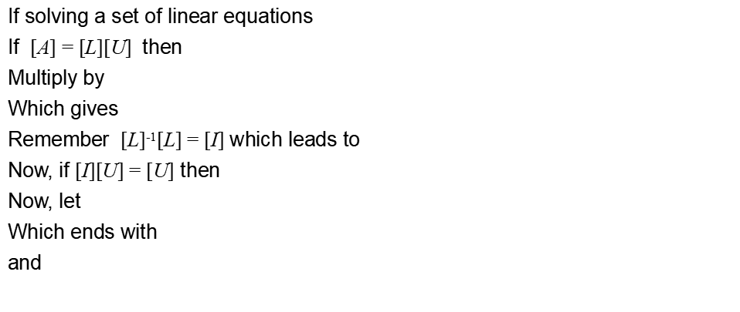
How does LU Decomposition work?
[A][X] = [C]
[L][U][X] = [C]
[L]⁻¹
[L]⁻¹[L][U][X] = [L]⁻¹[C]
[I][U][X] = [L]⁻¹[C]
[U][X] = [L]⁻¹[C]
[L]⁻¹[C]=[Z]
[L][Z] = [C] (1)
[U][X] = [Z] (2)

Slide 5
LU Decomposition
How can this be used?
Given [A][X] = [C]
Decompose [A] into [L] and [U]
Solve [L][Z] = [C] for [Z]
Solve [U][X] = [Z] for [X]

Slide 6
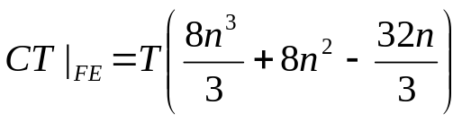
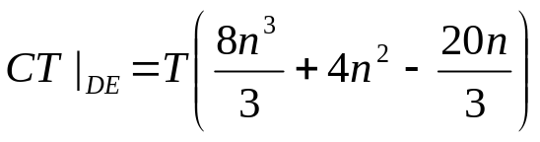


Is LU Decomposition better than Gaussian Elimination?
Solve [A][X] = [B]
T = clock cycle time and nxn = size of the matrix
Forward Elimination
Decomposition to LU
Back Substitution
Forward Substitution
Back Substitution

Slide 7
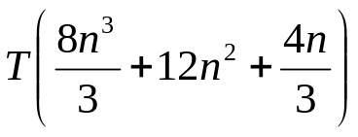
Is LU Decomposition better than Gaussian Elimination?
To solve [A][X] = [B]
Time taken by methods
T = clock cycle time and nxn = size of the matrix
So both methods are equally efficient.
Gaussian Elimination | LU Decomposition

Slide 8
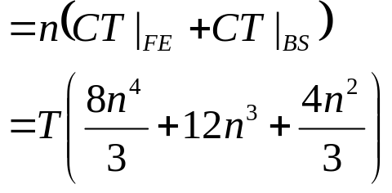
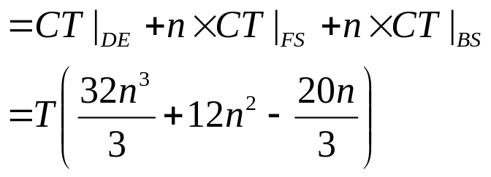
To find inverse of [A]
Time taken by Gaussian Elimination Time taken by LU Decomposition

Slide 9
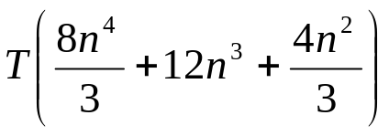
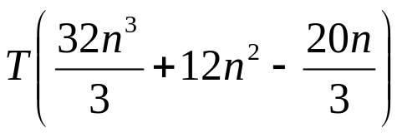
To find inverse of [A]
Time taken by Gaussian Elimination Time taken by LU Decomposition
Table 1 Comparing computational times of finding inverse of a matrix using LU decomposition and Gaussian elimination.
n | 10 | 100 | 1000 | 10000
CT|_{inverse GE} / CT|_{inverse LU} | 3.288 | 25.84 | 250.8 | 2501
For large n, CT|_{inverse GE} / CT|_{inverse LU} ≈ n/4

Slide 10
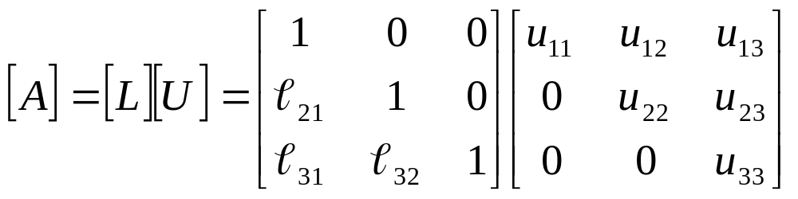
Method: [A] Decomposes to [L] and [U]
[U] is the same as the coefficient matrix at the end of the forward elimination step.
[L] is obtained using the multipliers that were used in the forward elimination process

Slide 11
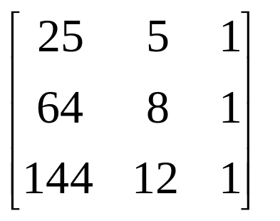
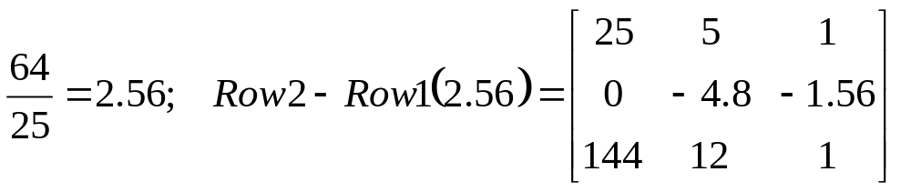
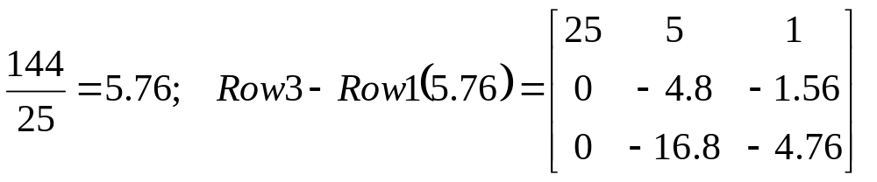
Finding the [U] matrix
Using the Forward Elimination Procedure of Gauss Elimination
Step 1:

Slide 12
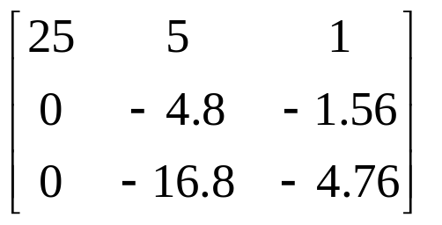
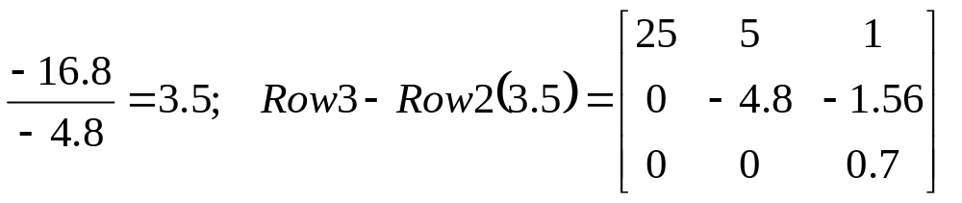
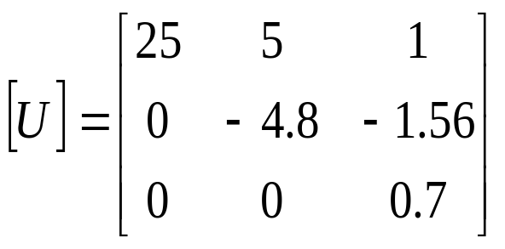
Finding the [U] Matrix
Matrix after Step 1:
Step 2:

Slide 13
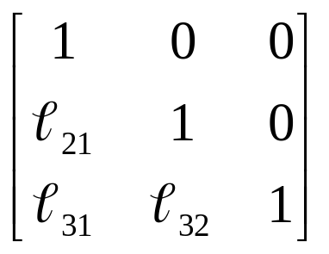
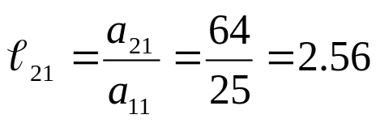
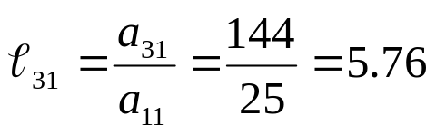
Finding the [L] matrix
Using the multipliers used during the Forward Elimination Procedure
From the first step of forward elimination

Slide 14
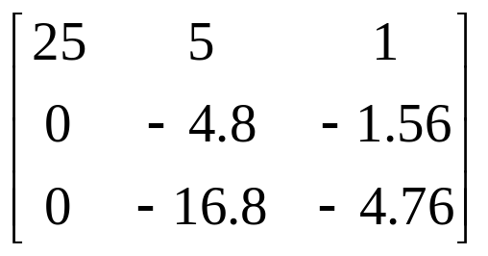
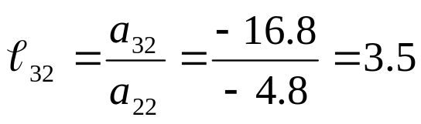
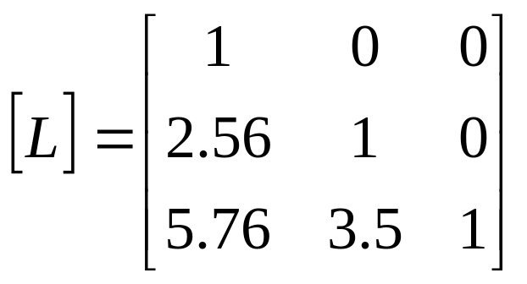
Finding the [L] Matrix
From the second step of forward elimination

Slide 15
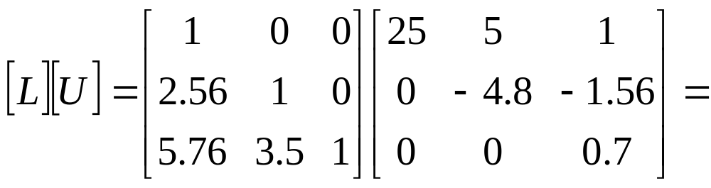
Does [L][U] = [A]?
?

Slide 16

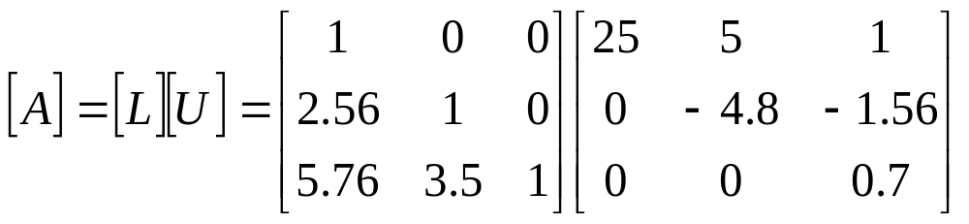
Using LU Decomposition to solve SLEs
Solve the following set of linear equations using LU Decomposition
Using the procedure for finding the [L] and [U] matrices

Slide 17
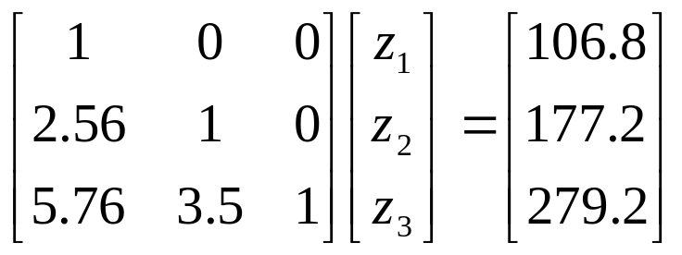
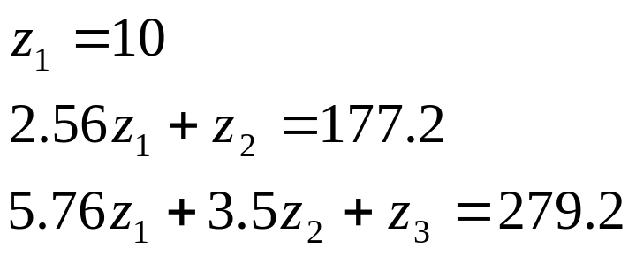
Example
Set [L][Z] = [C]
Solve for [Z]

Slide 18
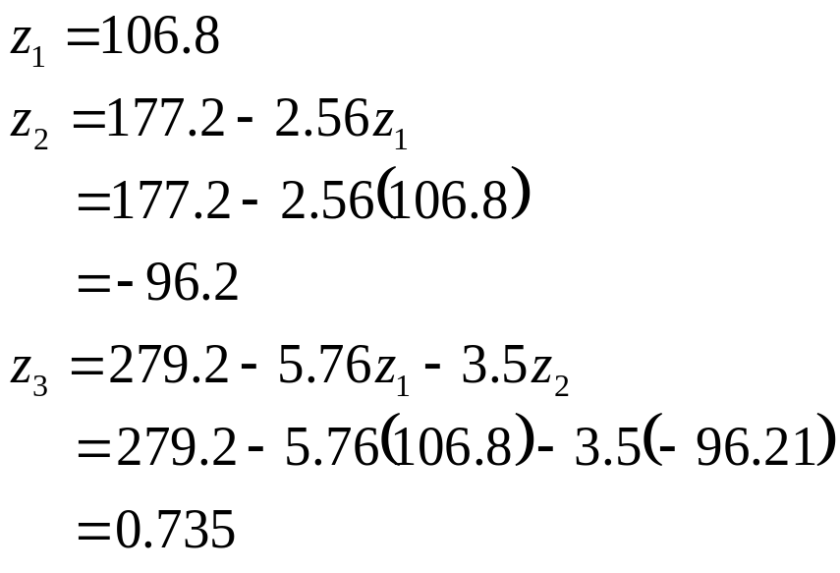
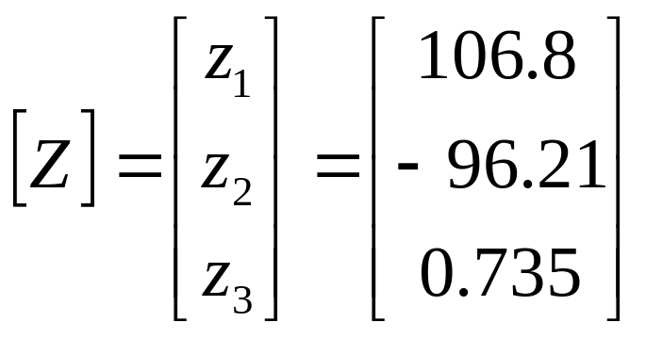
Example
Complete the forward substitution to solve for [Z]

Slide 19
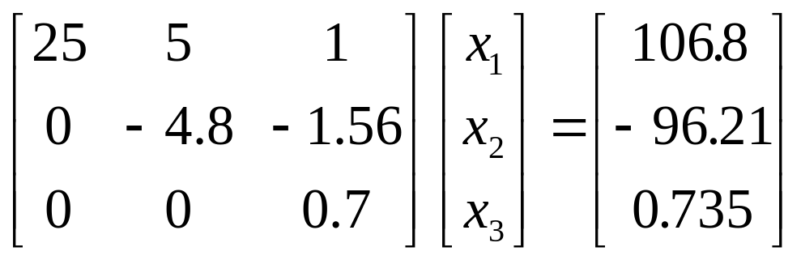
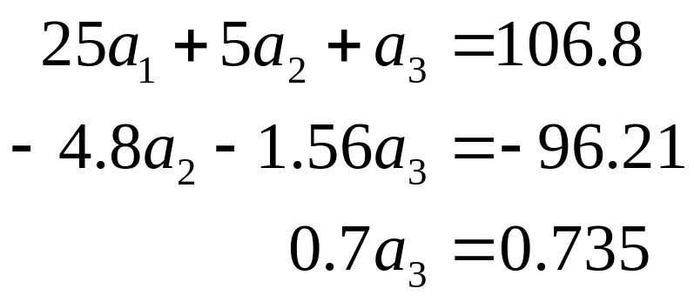
Example
Set [U][X] = [Z]
Solve for [X] The 3 equations become

Slide 20
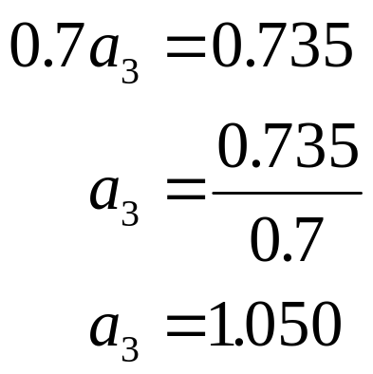

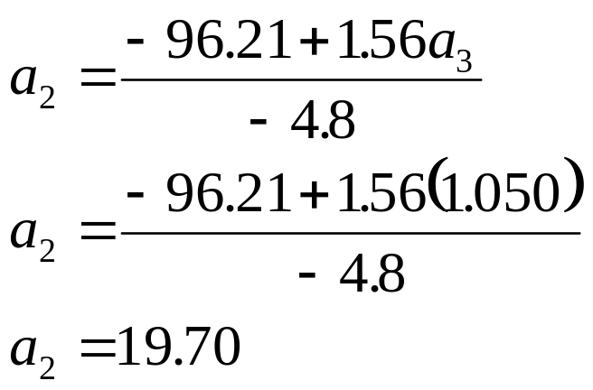
Example
Substituting in a₃ and using the second equation
From the 3rd equation

Slide 21

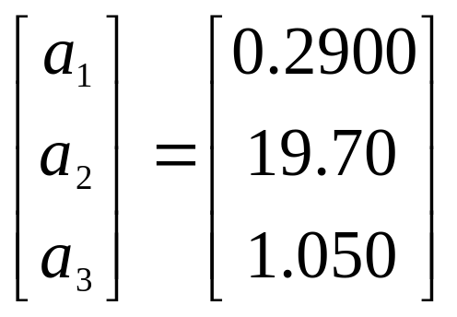
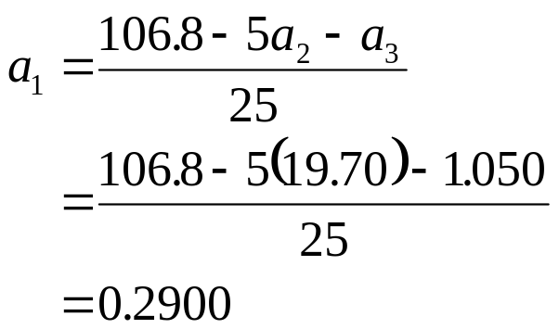
Example
Substituting in a₃ and a₂ using the first equation
Hence the Solution Vector is:

Slide 22
Finding the inverse of a square matrix
The inverse [B] of a square matrix [A] is defined as
[A][B] = [I] = [B][A]

Slide 23
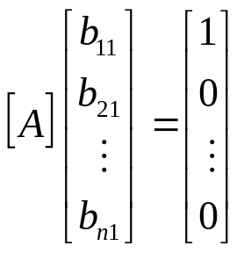
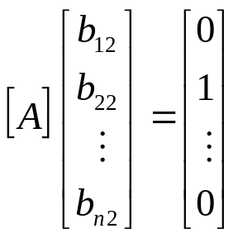
Finding the inverse of a square matrix
How can LU Decomposition be used to find the inverse?
Assume the first column of [B] to be [b₁₁ b₁₂ … b_{n1}]^{T}
Using this and the definition of matrix multiplication
First column of [B] Second column of [B]
The remaining columns in [B] can be found in the same manner

Slide 24
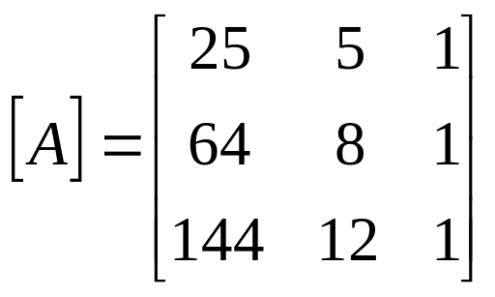
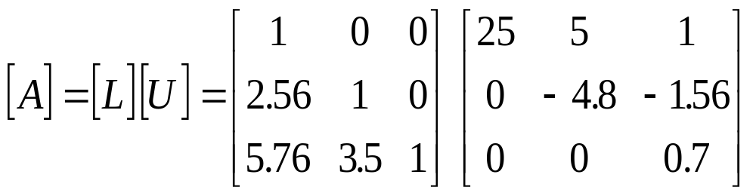
Example: Inverse of a Matrix
Find the inverse of a square matrix [A]
Using the decomposition procedure, the [L] and [U] matrices are found to be

Slide 25
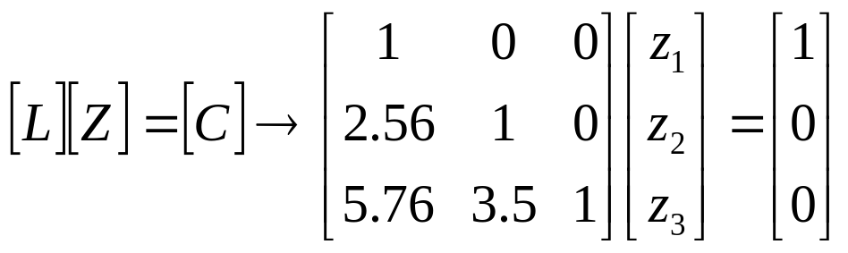
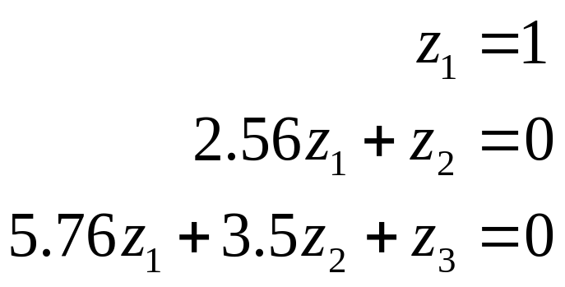
Example: Inverse of a Matrix
Solving for the each column of [B] requires two steps
Solve [L] [Z] = [C] for [Z]
Solve [U] [X] = [Z] for [X]
Step 1:
This generates the equations:

Slide 26
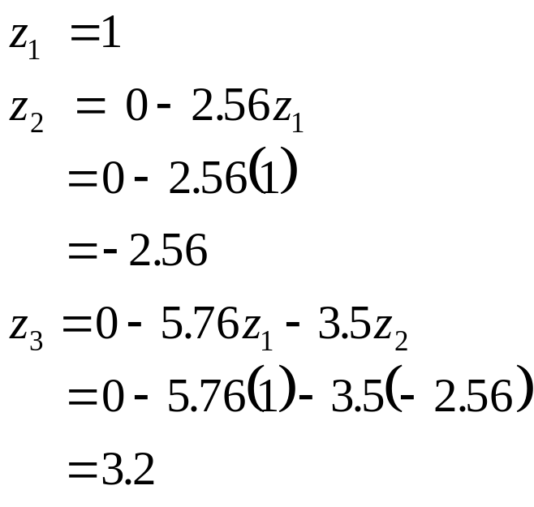
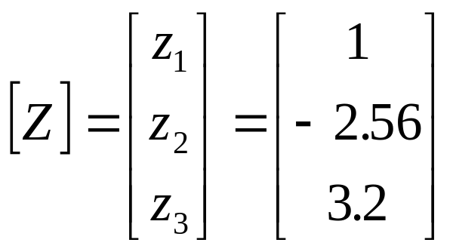
Example: Inverse of a Matrix
Solving for [Z]

Slide 27
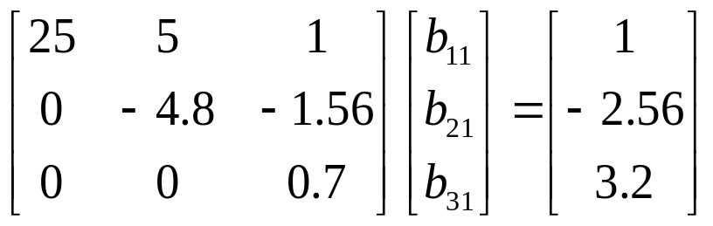
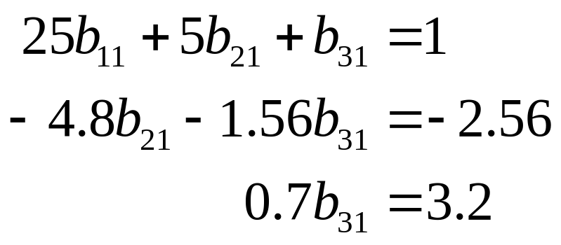
Example: Inverse of a Matrix
Solving [U][X] = [Z] for [X]

Slide 28
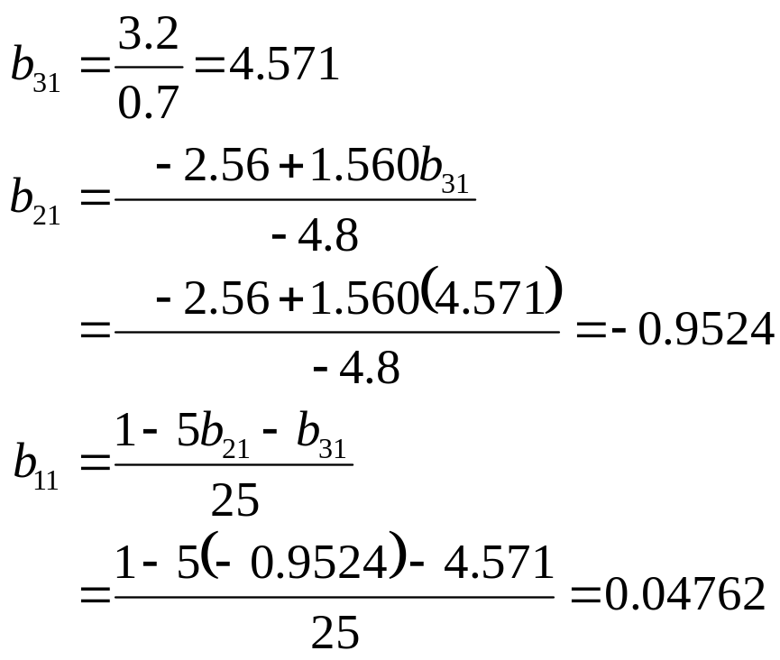
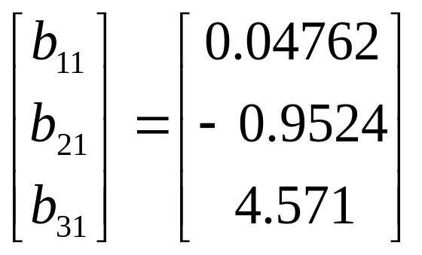
Example: Inverse of a Matrix
Using Backward Substitution
So the first column of the inverse of [A] is:

Slide 29
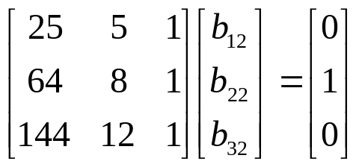
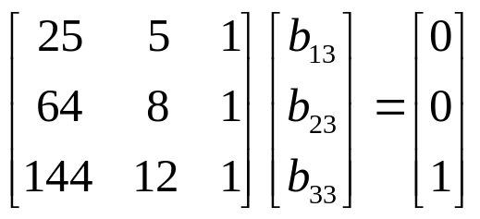
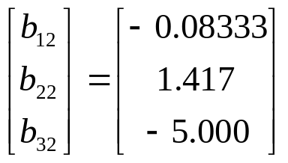
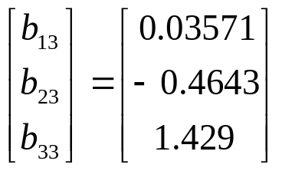
Example: Inverse of a Matrix
Repeating for the second and third columns of the inverse
Second Column Third Column

Slide 30
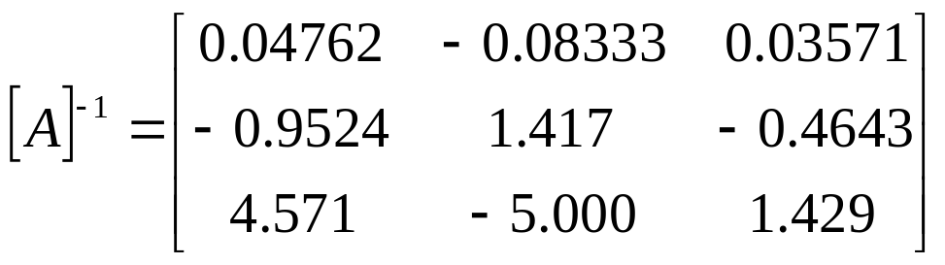
Example: Inverse of a Matrix
The inverse of [A] is
To check your work do the following operation
[A][A]⁻¹ = [I] = [A]⁻¹[A]

Slide 31
THE END

